Slide 1

AIML CA1
REGRESSION MODEL
Name: goh yu jie
Student id: p2415901

Slide 2
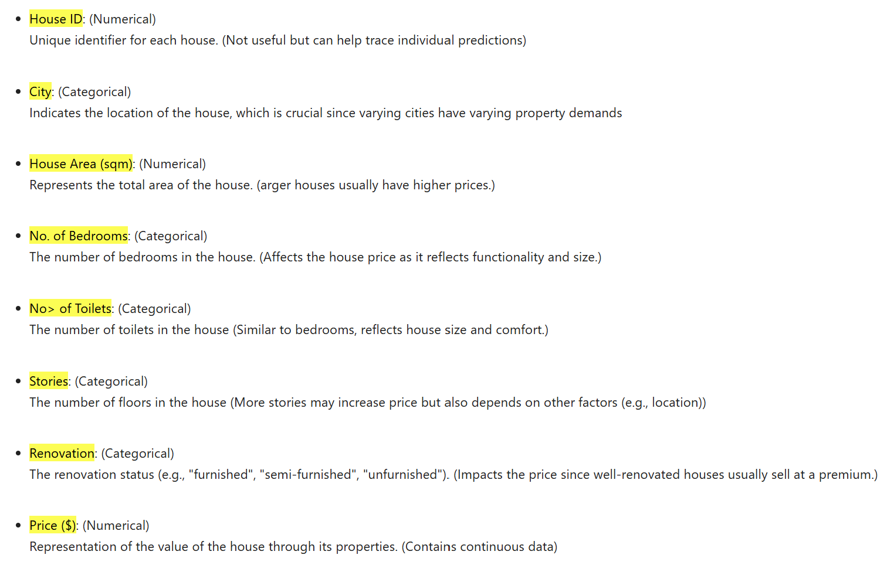
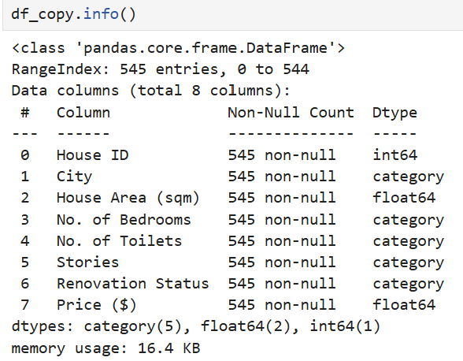
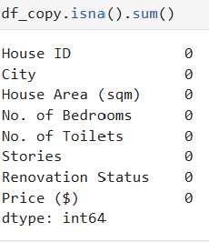


Exploratory Data (EDA)
Overview of entire data
1) Meaning of all variables involved
2) Description of the entire dataset
3) Checking for missing values
4) Check for duplicates
rows
columns

Slide 3
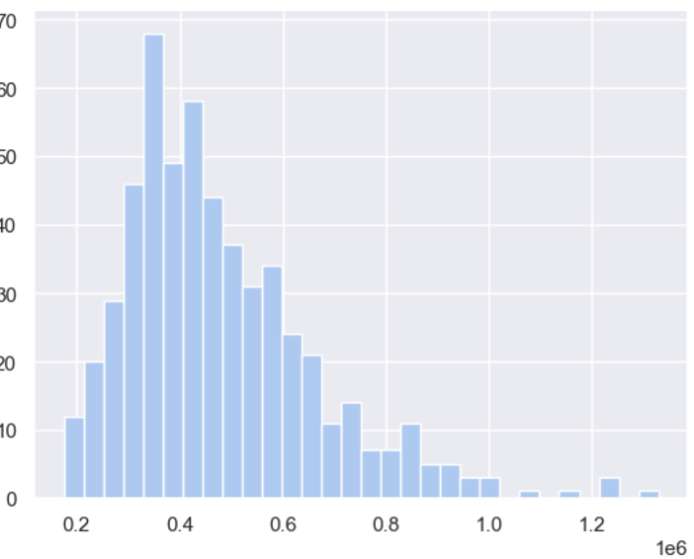
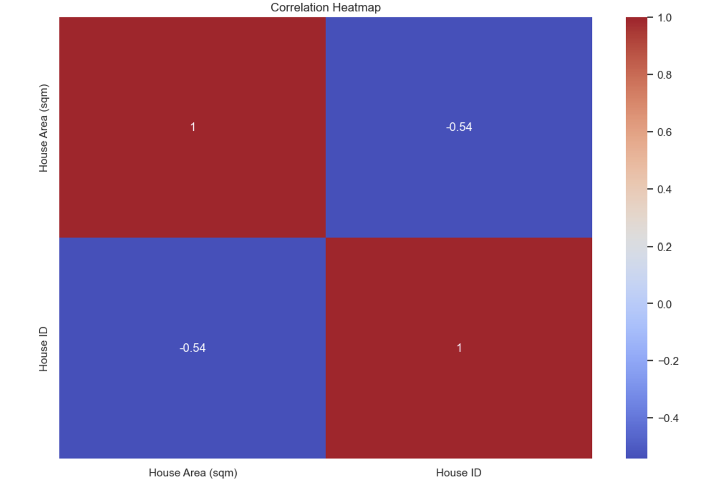
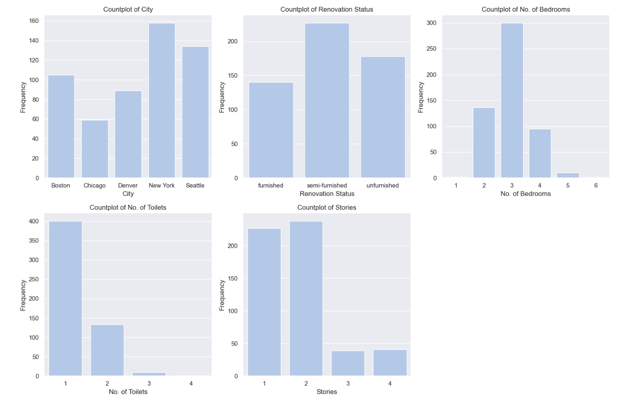
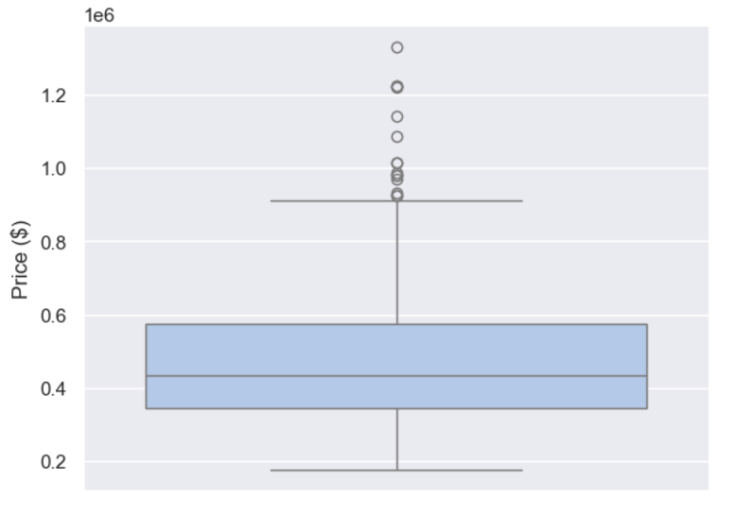
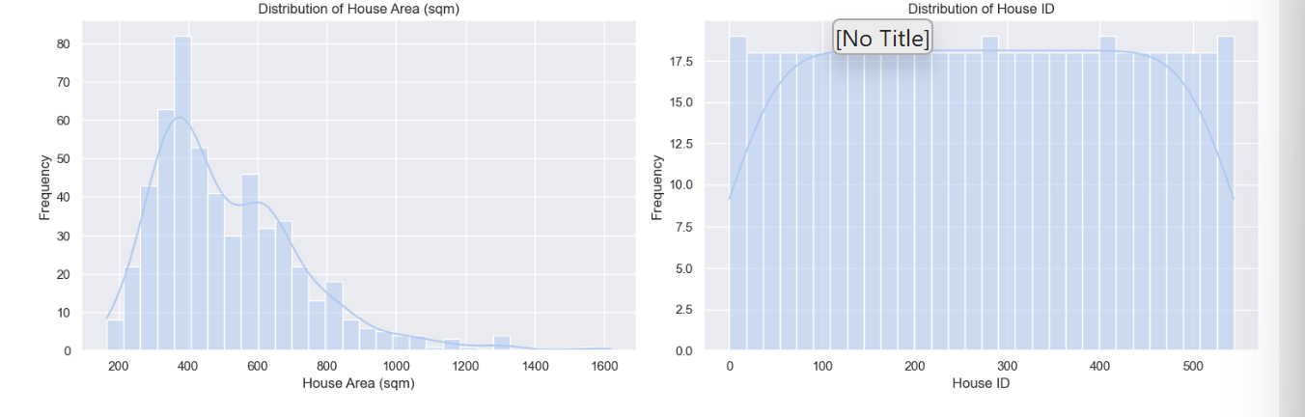
EDA (Target and variables indiv.)
Right skewed (Transform)
5)Visualising target
6)Visualising numerical variables
7)Visualising categorical variables
Conclusions
In summary, the heatmap shows that there is a moderate negative correlation (-0.54) between "House ID" and "House Area (sqm)". This means that, in this dataset, houses with higher IDs tend to have smaller areas in square meters.
Outliers on the top (Might Standardize)
From above, we can see the frequency/count of which classes in each of the categories, occurs most and which classes occurs least. What is interesting to me is that there are some classes that does not have any frequency. No frequency may raise biasness as we encode later.
Right skewed (Transform) for just one variable
Good to know because we have to encode them later on

Slide 4
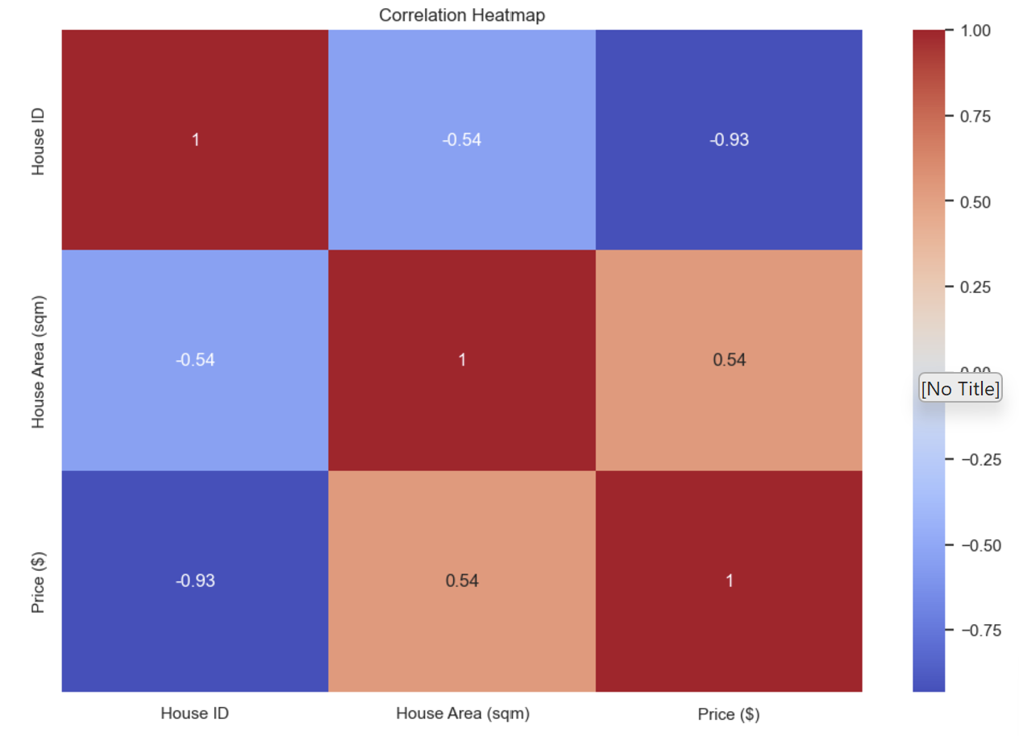
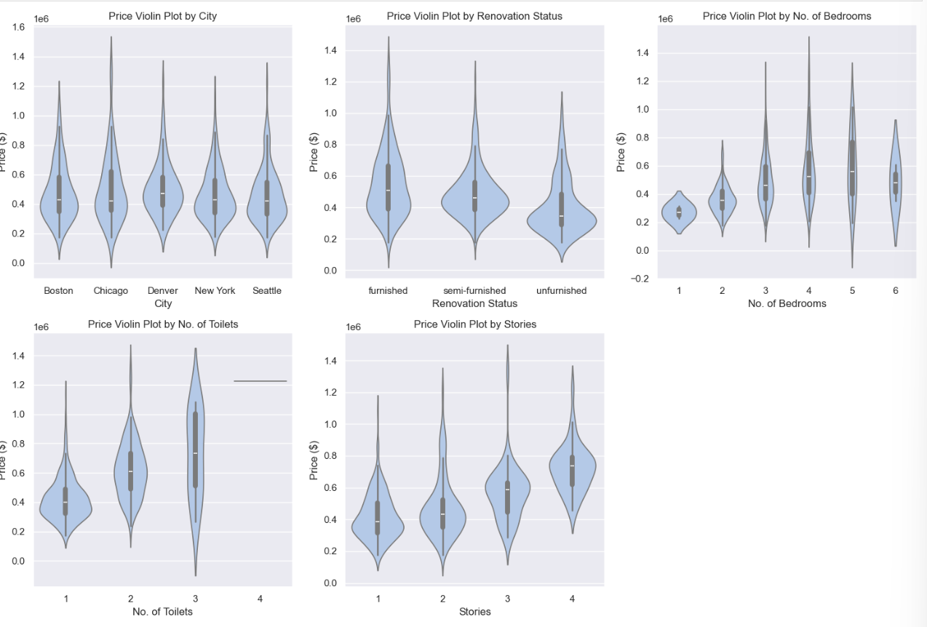
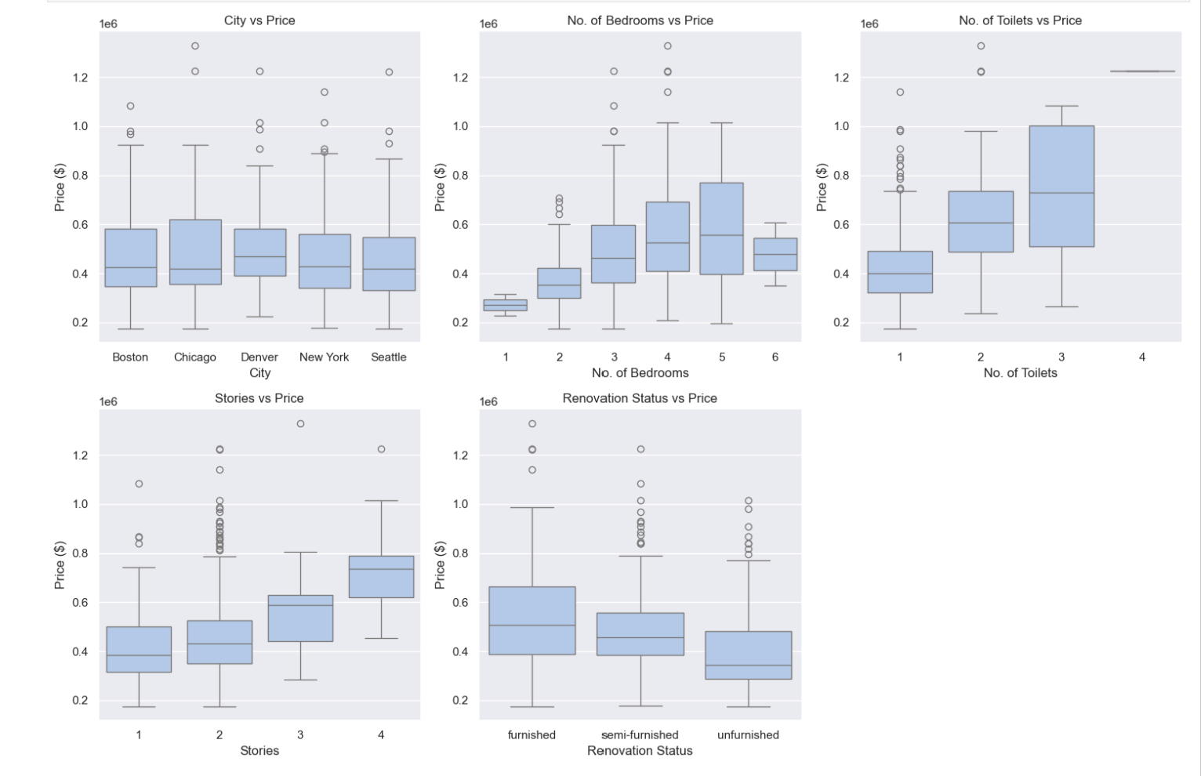
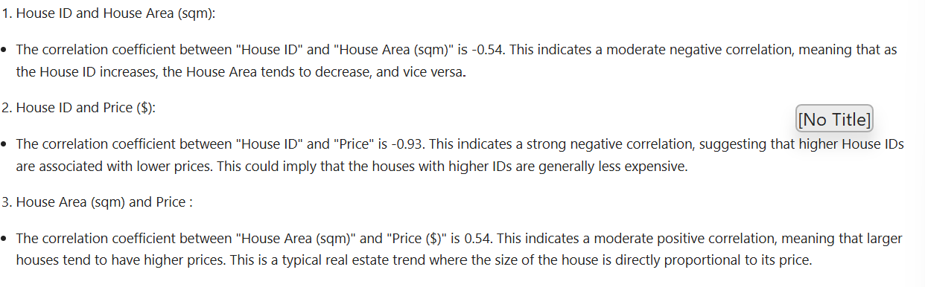
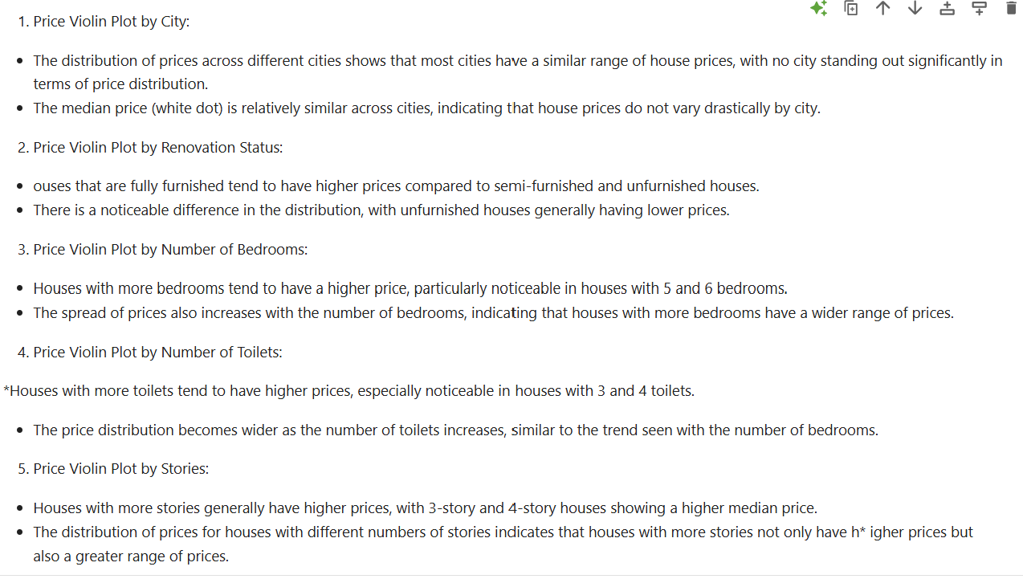
EDA (Target with variables)
8)Numerical against price
9)Categorical against price
10) Something interesting with the order
The boxplot provided shows an unusual ordering of the number of bedrooms: 1, 2, 3, 6, 4, 5. This ordering suggests that the data might not be sorted correctly by the number of bedrooms, which could be an issue with how the categorical data for "No. of Bedrooms" was handled or encoded.

Slide 5


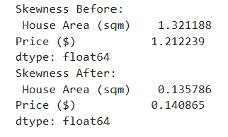
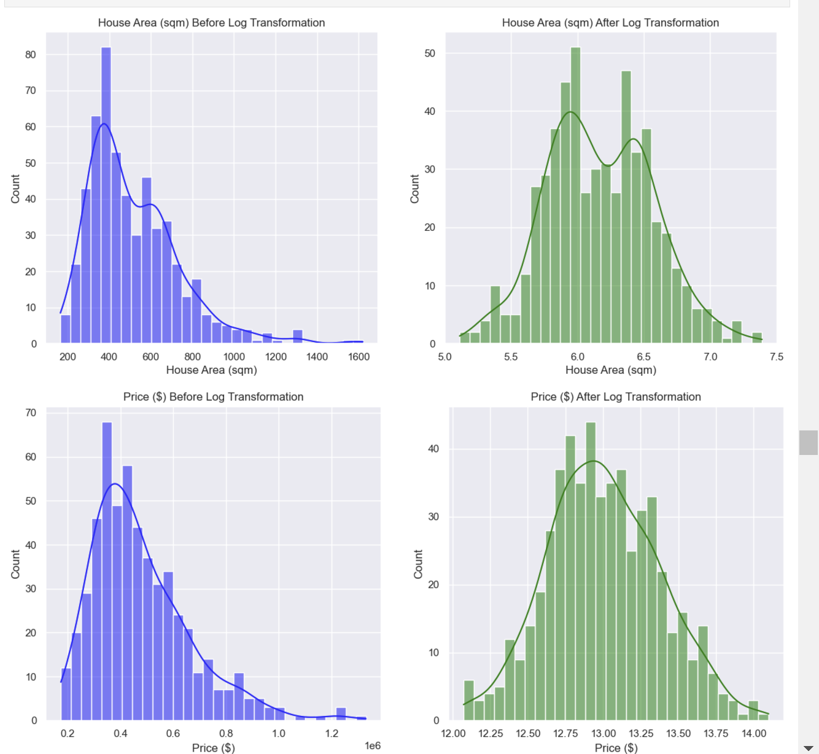
Data preprocessing
1) Dropping irrelevant columns
2) Handling skewness of feature and target

Slide 6
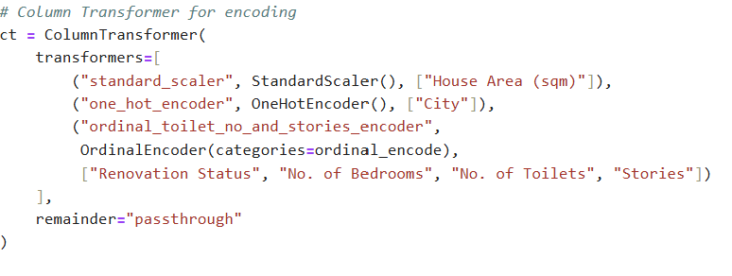
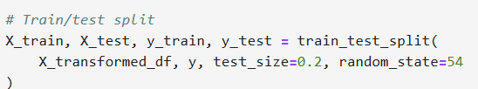

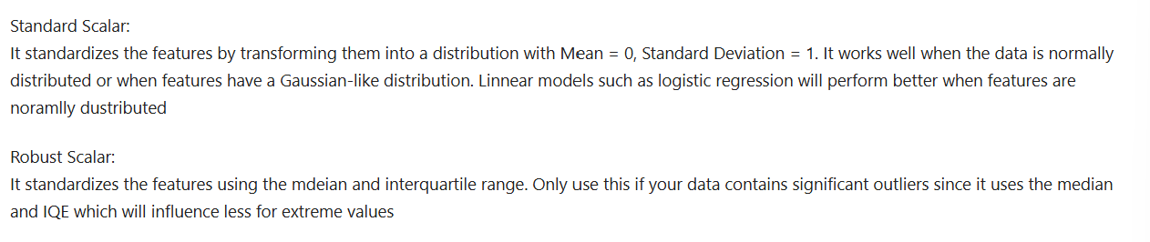
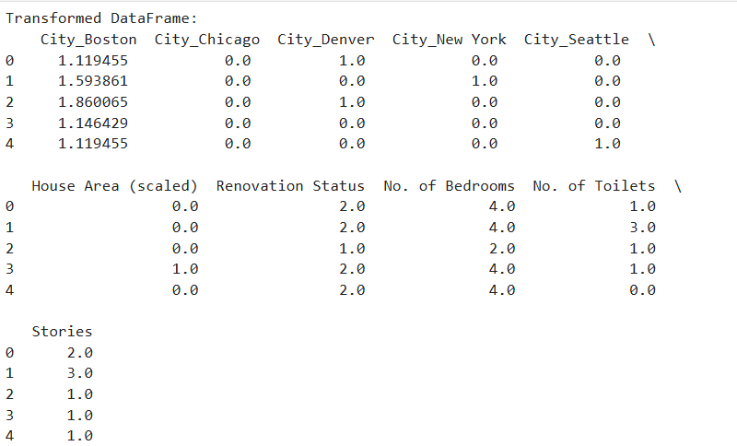
Data preprocessing (2)
3)Encoding of categorical features + scaling
4) Splitting data
Results of splitting which affects the rows but not columns
Reduces influence of outliers and this can be seen from interquartile range

Slide 7
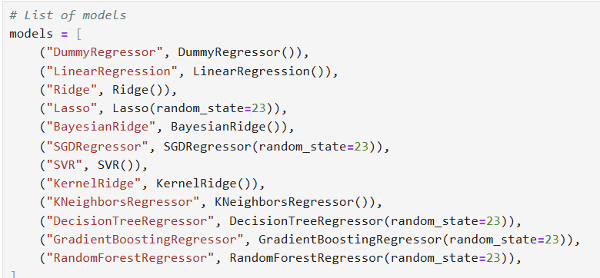
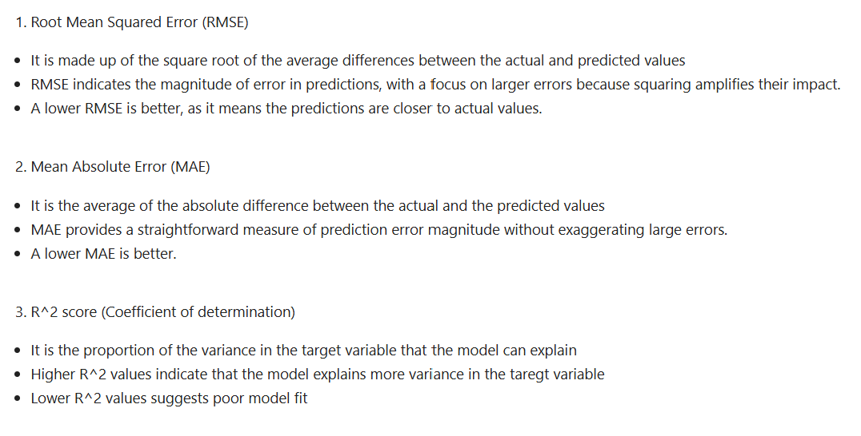
Model Selection
1) Models that will be used
2) Understanding the metrics that are used
Accesses effectiveness of models

Slide 8
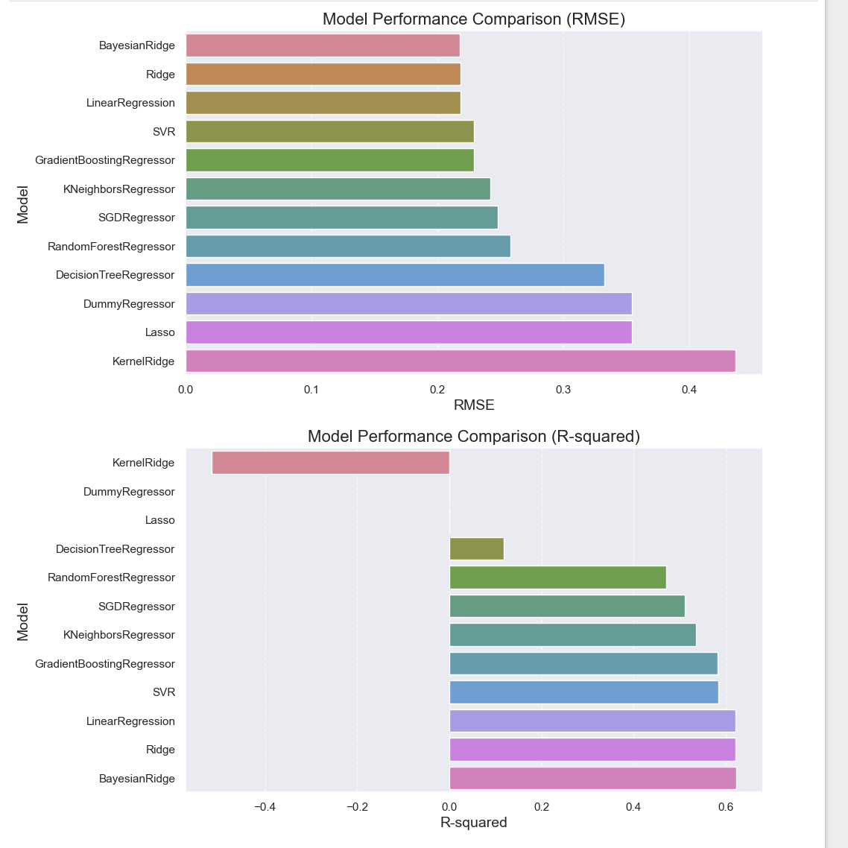
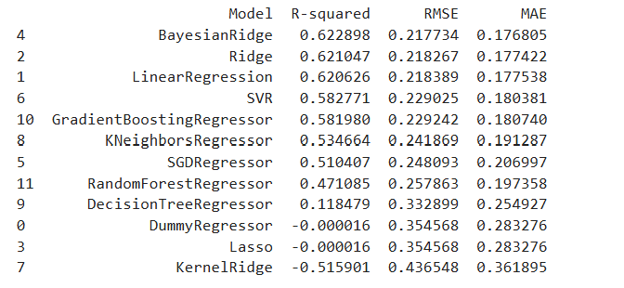
Model Selection (2)
3) Evaluating results

Slide 9
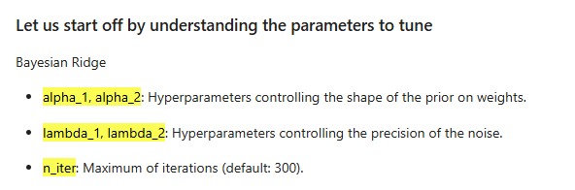
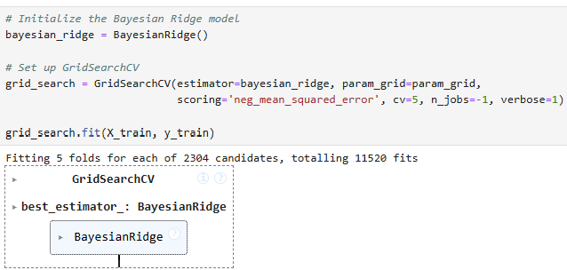
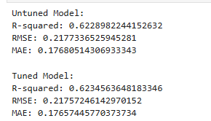
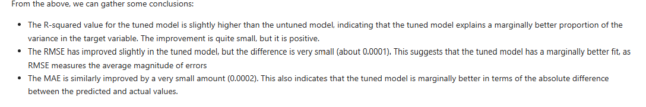
Hyper tuning best model
(Bayesian Ridge)
1) Understanding parameters
2) Use of GridSearchCV
3) Analysing results
find the optimal combination of hyperparameters for a given model to improve its performance.

Slide 10
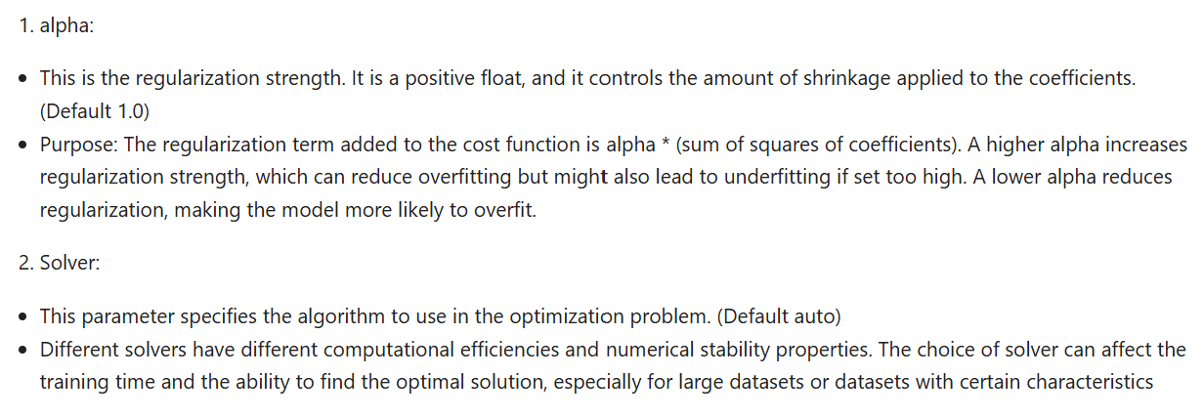
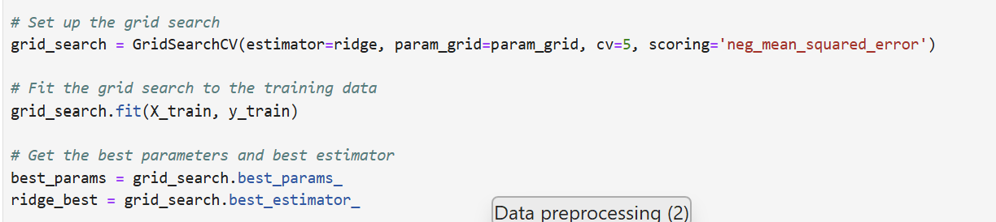
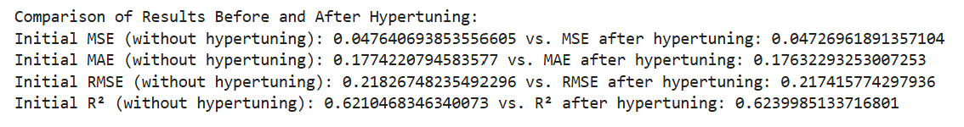
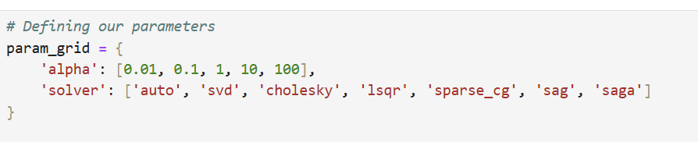
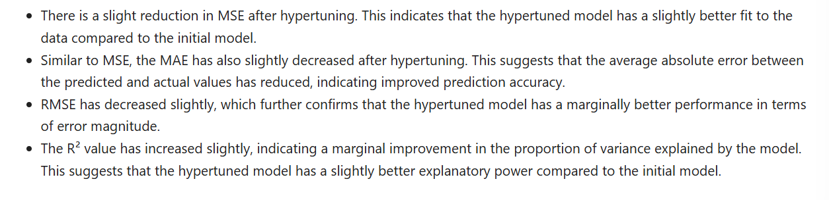
Hyper tuning best model (2)
1) Understanding parameters
2) Use of GridSearchCV
3) Analysing results

Slide 11
Conclusions:
Top performers
Middle performers
Lower performers
(Bayesian Ridge, Ridge, Linear Regression)
(SVR)
(KNeighborsRegressor)
These models assume a linear relationship between the input features and the target variable. When this assumption is met, they perform very well.
effective in capturing non-linear relationships by using kernel functions but can be computationally intensive and sensitive to choice of hyperparameters and kernel used
non-parametric method that makes predictions based on the k-nearest neighbors in the feature space. But Performance can degrade if the dataset is large or if the number of features is high.
(Gradient boosting regressor)
(SGDRegressor, RandomForestRegressor, DecisionTreeRegressor)
They are less sensitive to multicollinearity (when independent variables are highly correlated), making them robust for many datasets.
an ensemble technique that builds models sequentially, with each new model correcting the errors of the previous ones but requires careful tuning of hyperparameters to avoid overfitting and to optimize performance.
SGDRegressor: Uses stochastic gradient descent, which can be effective for large-scale problems but may require extensive tuning.
RandomForestRegressor: An ensemble of decision trees that reduces overfitting by averaging multiple trees. However, it may not perform well if not properly tuned.
DecisionTreeRegressor: Highly interpretable but prone to overfitting, especially with small datasets.

